Slide 1
Knowledge and politics of the body
2nd class on the sociology of medicine and health

Slide 2
Review and Plan
Last time
Socioeconomic gradients in health, and mortality rates
The role of universal medical care/easy access to healthcare
Demographic (race, ethnic, gender, and marital) differences in health
Today:
How the production of medical knowledge is conditioned by historically and culturally specific epistemological lenses?
How the body could be seen as a realm of political and power struggle?

Slide 3
On one hand, the body is a biological entity.
But everything we believe we “know” about the body is perceived through culture— therefore, the body is culturally constructed.

Slide 4
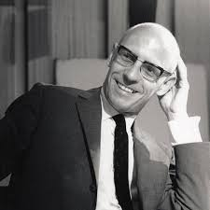
The thinker at the background: Michel Foucault (1926-1984, France)
Main theme: The relationship between power and knowledge in the constitution of the self
Main method: Historical investigations (what he calls “archeology”) of various domains of social institutions that invented techniques/technologies of control before and after the advent of modernity (e.g., Madness, sexuality, prison)
Echoing works of: Marx (leftists thinking), Nietzsche (genealogy of morals), and Freud (the definition of the “abnormal”)
➔ The darker side of the enlightenment project

Slide 5
A taste of Foucault’s work (1): Madness and Civilization
The Renaissance (14-17th century)
Cosmic tragedy of the mad who communicate with the reasonable
The “Classical Age” (17th -18th century)
“The Great Confinement” in Europe, the mad separated together with vagabonds, prostitutes and the like.
The modern period of reason
Dedicated institutions that confine and “cure” the mad
Total separation between the mad and the reasonable
Madness: natural object for scientific study
The mad: subject to the monologue of reason in psychiatric knowledge
The mad: possesses wisdom about the limits of our world
Notes:
The mad were portrayed in art as possessing a kind of wisdom, as engaged with the reasonable while representing the mysterious forces of cosmic tragedy
A similar note: Shamanism in Hmong?
conceptual distinction between the mad and the rational was in a sense a product of this physical separation into confinement: confinement made the mad conveniently available to medical doctors who began to view madness as a natural object worthy of study and then as an illness to be cured

Slide 6
Of course we shouldn’t over-romanticize the sufferings of the mad… (Luhrmann 2001)
“Despite all his insights, [Foucault] did a terrible disservice to its pain.” (p11)
“Madness is real, and it is an act of moral cowardice to treat it as a romantic freedom.” (p12)

Slide 7
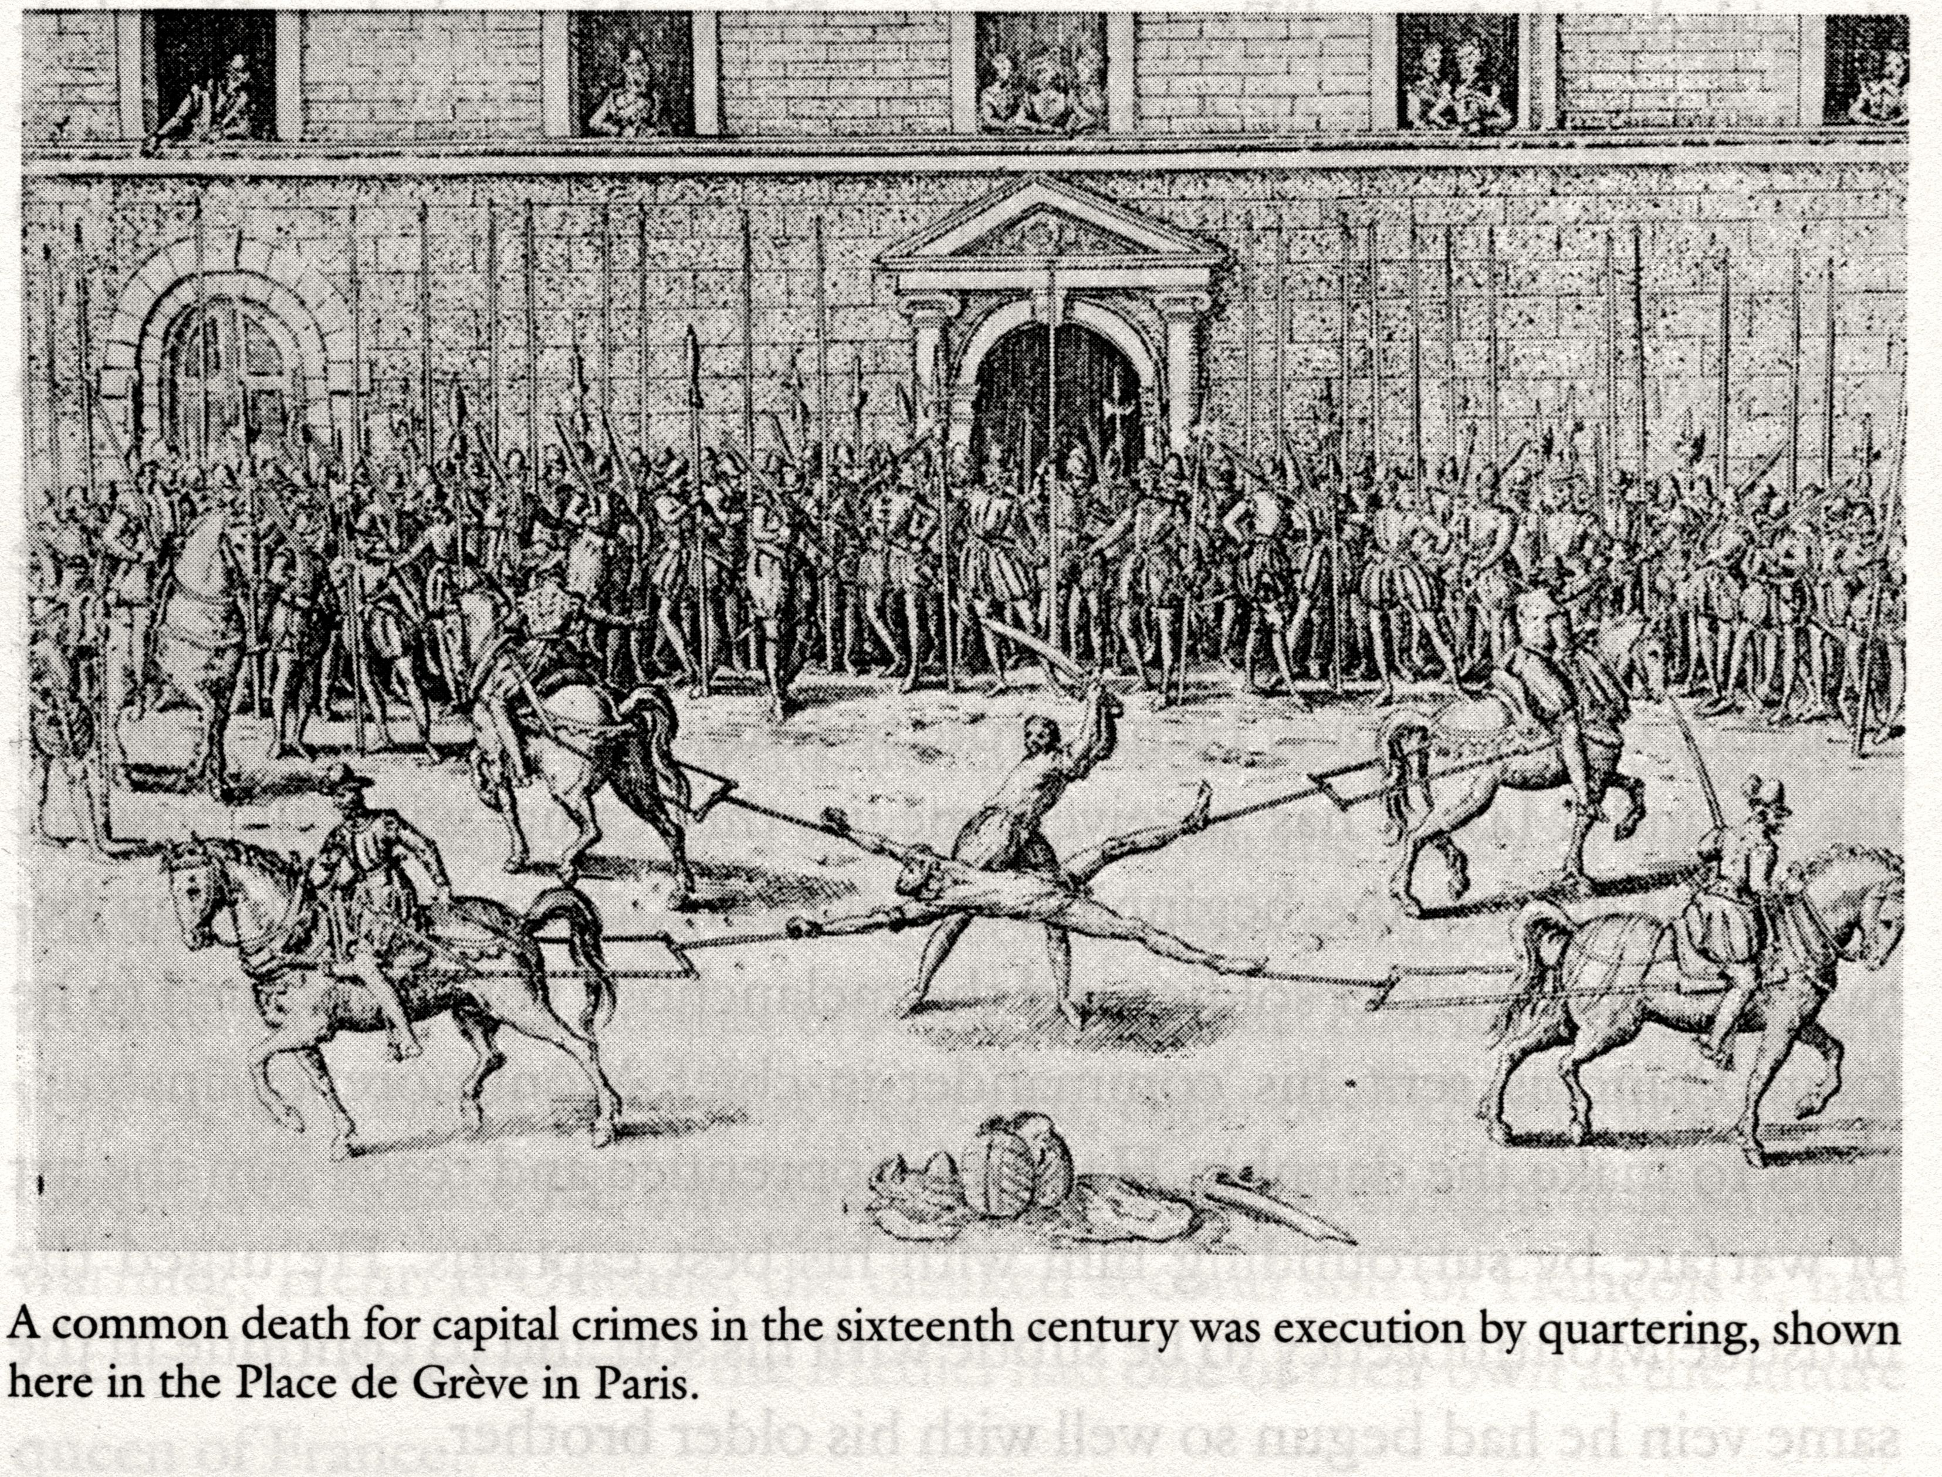
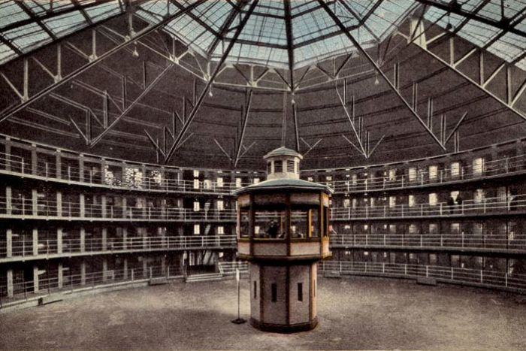
A taste of Foucault’s work (2): Discipline and Punish
But you get the kind of lens Foucault’s “archeology” provides for our understanding of the relationship between knowledge and power…

Slide 8
Foucault pays much attention to the body: “biopower”, “biopolitics”
(Recall Wing-Chung Ho (2005), Biopolitics, Occupational Health and State Power: The Marginalization of Sick Workers in China.)
The transition in the 19th century: take life or let live ➔ "make" live and "let" die. (p241, Society must be defended)
The economic function of life for the state
The body provides the most basic and important form of labor
The rise of statistics to surveil and control the rates of life, death through for instance census
People cannot just live, they need to live “well”, and this “well-being” must be quantified, calculated, and measured
Governmentality => “govern”+ “mentality”

Slide 9
The cultural and historical specificity of medical knowledge
Subjective experience of health and illness is socially embedded
E.g., “idiom of expression”: the way in which distress and illness (recall how illness distinguishes from disease) are expressed vary by culture and individuals
E.g., “somatization” of depression in Asian population

Slide 10
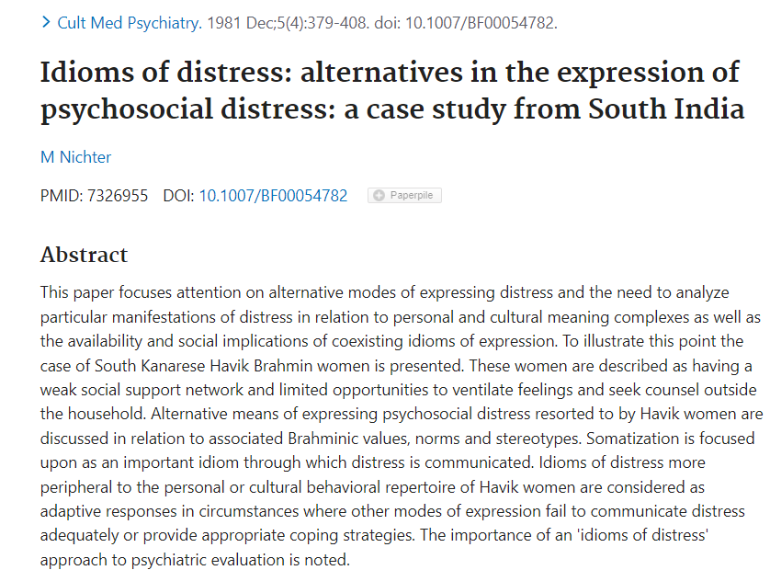

Slide 11
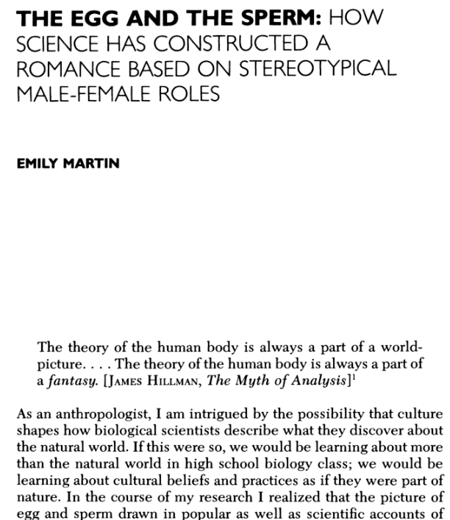
1. Mensuration vs ejaculation 2.

Slide 12
The cultural and historical specificity of medical knowledge
Subjective experience of health and illness is socially embedded
E.g., “idiom of expression”: the way in which distress and illness (recall how illness distinguishes from disease) are expressed vary by culture and individuals
E.g., “somatization” of depression in Asian population
Medical knowledge and beliefs are contingent on our social imaginations and understandings of the body.
E.g., Foucault’s Madness and Civilization
For Foucault, not only knowledge is shaped by the historical time, but the body itself too.
E.g., the invention of Post-Traumatic Stress Disorder (Young 1997)

Slide 13
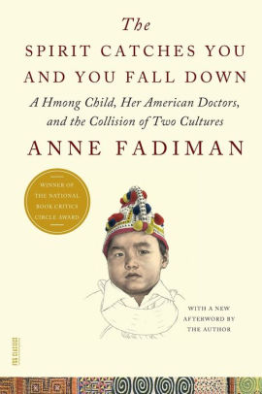
Case: “信则灵”？
The spirit catches you and you fall down
Hmong women are silent when they give birth to children, which irritates the American nurses who were trained that childbearing is one of the most painful experience in one’s life.
Lia suffered from a major seizure which made her vegetate for the rest of her life after her parents’ compliance to American doctors’ prescriptions.

Slide 14
Case: The outbreak of multiple personality disorder
The Politics of Hysteria” by Joan Acocella
“Between 1985 and 1995 there were almost 40,000 new cases--mostly women--and the disease acquired a valid standing in the field of psychoanalysis. M.P.D. patients are susceptible to therapists' suggestions because they are given strong medications and are highly hypnotizable. Both M.P.D. and recovered memory are in large part feminist movements: female "victims" confronting their abusers.”
“The number of reported M.P.D. cases has significantly declined since the mid-'90s. Ultimately, the cause M.P.D. most damaged was feminism: point for point, M.P.D. repeats the old weak-woman stereotype. Elizabeth Carlson eventually sued her therapist and won several million dollars in damages; in 1993, she founded the National Association Against Fraud in Psychotherapy.”

Slide 15
Ecology, biopolitics, and state politics
Socioeconomic and ethnic disadvantages ➔ heightened health risks by virtue of exposure to hazardous environmental conditions
The mutual dependence between vultures and people in India
The story of agent orange as a repercussion of the Vietnam war
Occupational disease?

